Slide 1
BATCH SCRIPTING
Introduction to Batch Scripting:
Name: Mohammad Mohid.
Program: Data Science.
Semester: I

Slide 2

What is Batch Scripting?
A text file with commands.
MAIN CONCEPT:
Automate repetitive tasks.

Slide 3

Why is Batch Scripting
used?
Automates repetitive tasks.
Reduces manual work.
Easy to learn and use.

Slide 4
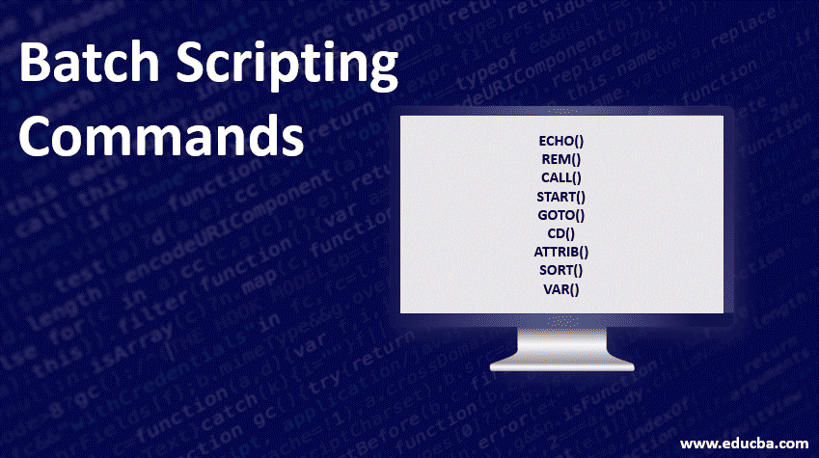
BASIC COMMANDS:
Batch Scripts are made up of series of commands.
ECHO (echo)
DIR (dir)
CD (cd)
CLS (cls)
EXIT (exit)
PAUSE (pause)

Slide 5

BATCH SCRIPTING LIMITATIONS:
LIMITED FUNCTIONALITY
CROSS PLATFORM

Slide 6

ALTERNATIVES TO BATCH SCRIPTING:
PowerShell:
More advance.
Supports modern data types.
Python:
Supports cross platform.
Easier to writer.

Slide 7
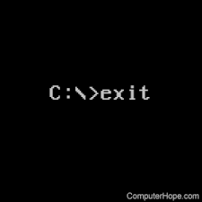
CONCLUSION:
Valuable tool for automating everyday tasks on windows.
Easily accessible.
Easy to learn.

